Slide 1
Introduction to Linux for Bioinformatics
Practical Class
2017-02-06
Tong Yin

Slide 2
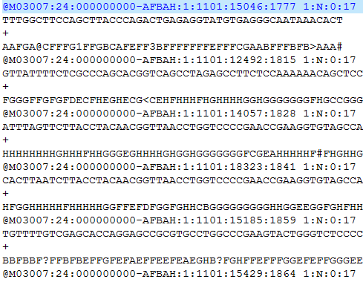
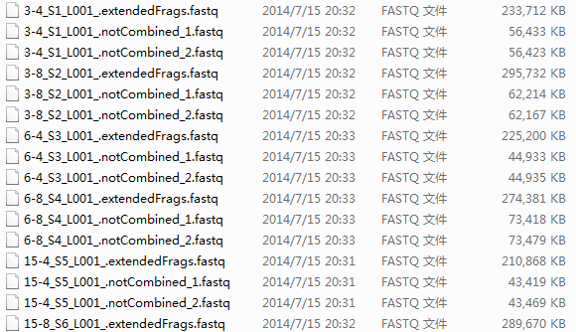
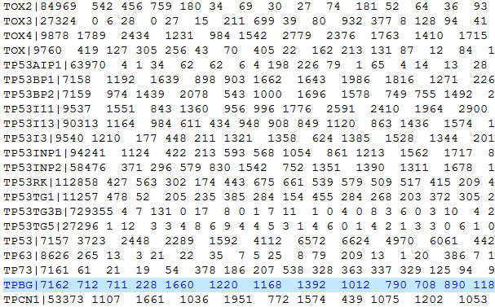
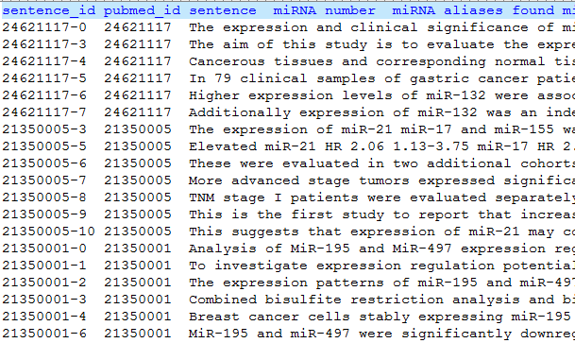
Natural fit of bioinformatics and Linux
One of the most basic tasks in bioinformatics is data mining, that need to store and handle big data.

Slide 3
Natural fit of bioinformatics and Linux
Needs more processor power and more hard drive space than a typical personal computer
Computers that can provide this power generally use the Linux/UNIX operating system, which is stable and efficient
Linux comes with a lot of tools to manipulate / search / analyse text files. It's similar to Bioinformatics, which stores data also in large text files.
Most of bioinformatics software is created and can only be used in Linux/Unix

Slide 4
bioinformatics tools in Linux
mySQL bio-database construction
Perl - programming language
Blast - similarity search
Clustal - multiple alignment
Phylip - phylogenetics
Phred/Phrap/Consed/SOUP/Picard/GATK - genome assembly and SNP detection

Slide 5
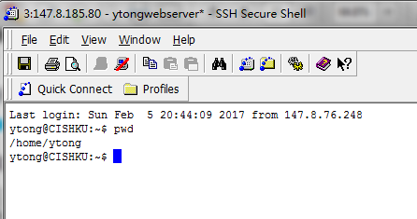
First step: a terminal
A terminal is a control panel that accepts only input from the keyboard, the command line. You can only type. What you type will get interpreted by the program Bash, which will then do what you are asking.

Slide 6
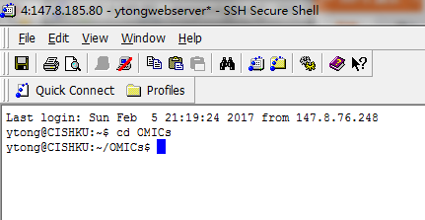
What's in your terminal
A command line is always located somewhere in the file system.
By default it shows: Username @ Machinename Current location ('working directory'),

Slide 7
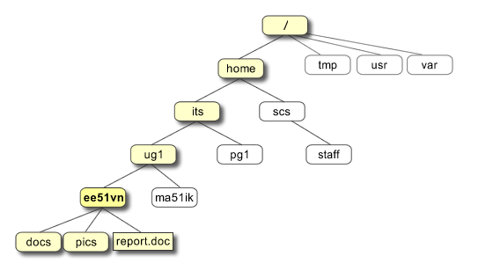
Linux file system
All the files are grouped together in the directory structure. The file-system is arranged in a hierarchical structure, like an inverted tree. The top of the tree is traditionally called root.

Slide 8
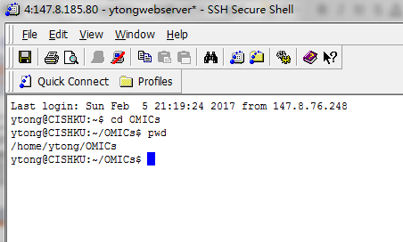
Check where are you
pwd = print working directory
After typing your command, press <enter> to execute this command
What you type is case-sensitive: capital A and lower a are different

Slide 9
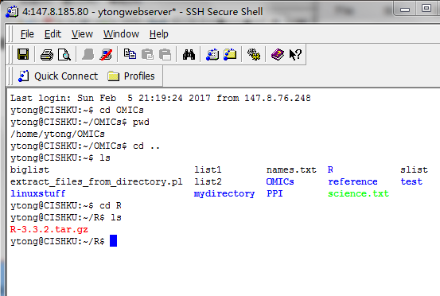
Navigating in the file system
ls = list contents of current directory
cd = change to target directory

Slide 10
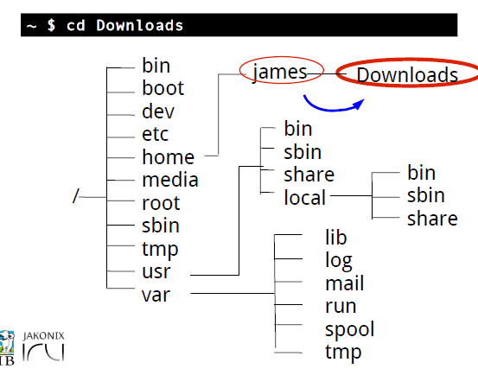
Paths and the working directory

Slide 11
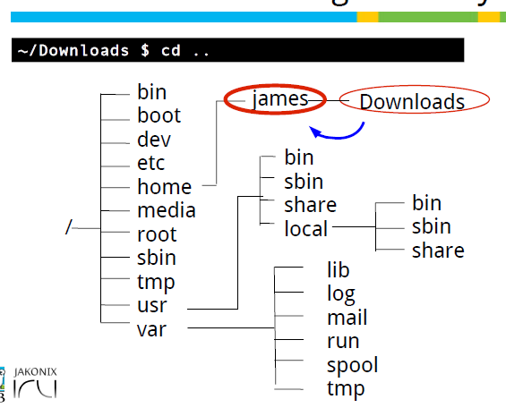
Paths and the working directory

Slide 12
Connet to our linux server
We have already created you your linux account in our linux server. In this semester, you can login on our server and finish all your tasks in this course
email:
account name:
password:

Slide 13
Client
You need to use client software to login our server.
Download putty: https://intranet.cs.hku.hk/csintranet/contents/technical/howto/ssh.jsp

Slide 14
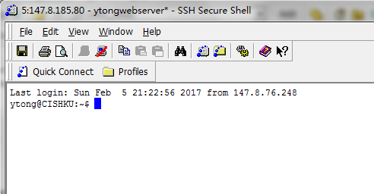
SSH Secure Shell Client
Download ssh shell: https://intranet.cs.hku.hk/csintranet/contents/technical/howto/ssh.jsp

Slide 15
terminal for mac os
Open terminal
Type:
$ ssh demon@

Slide 16
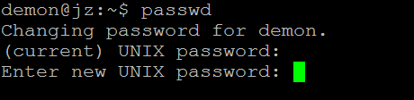
passwd
Change your personal password
$ passwd

Slide 17
Visit our web tutorial at http://cis.hku.hk/tutorial/ for detailed instruction

Slide 18
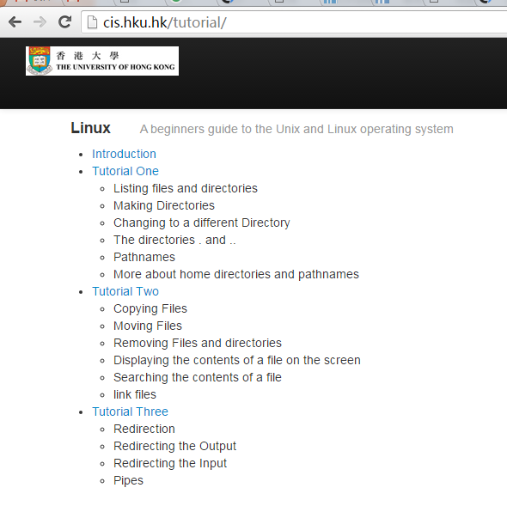

Slide 19
Save the screenshots of the questions and exercises in a report, and email them to u3003407@hku.hk
You can begin now !

